Slide 1
Git Logic: Updating from Upstream
3. Overnight, the Git Fairy adds some files to the repository
(upstream) BeaverWorksMedlytics2020/Week1_Public
1. Click the “Fork” button on GitHub.com
(remote) jmontgom10/Week1_Public
2. Clone your online fork to your local hard drive
4. Fetch the “upstream/master” changes
5. Merge “upstream/master” branch into your “master” branch
6. Push your updated branch to GitHub.com
(local) C:\Users\Jordan\Week1_Public

Slide 2
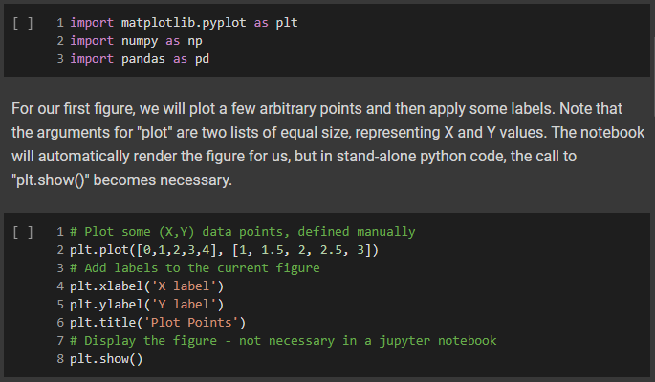
Git Logic: Working with Colaboratory
3. Make changes with Colab editor
4. Save directly to your copy on GitHub.com
2. Open your updated notebook in Google Colab
(remote) jmontgom10/Week1_Public
1. Push your updated branch to GitHub.com
(local) C:\Users\Jordan\Week1_Public

